Slide 1

ME-2023 MANUFACTURING ENGINEERING
REVERSE ENGINEERING OF SOLDERING IRON
GROUP MEMBERS | INDEX NO.
Andrew Ferdinan.S | 190170D
Mathiyalagan.V | 190387A
Mithunraaj.S | 190393M
Rathees.T | 190512F
Ravinath.S | 190524T
Mechanical engineering department,
University of Moratuwa

Slide 2
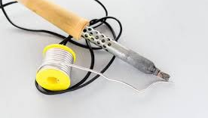
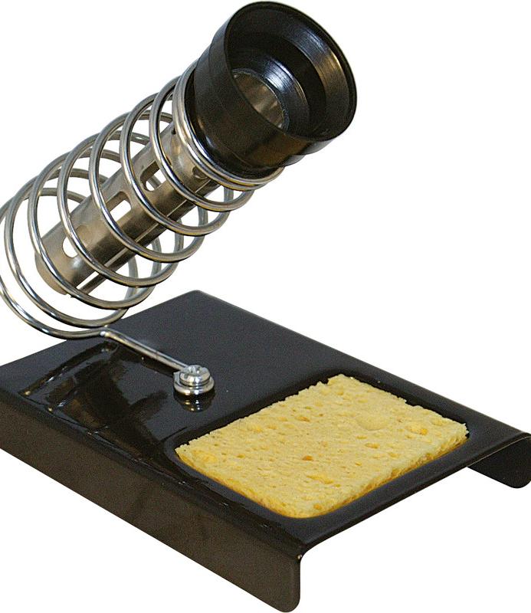
Function and features of soldering iron
Introduction
Soldering is a main process used in manufacturing devices. There are several types of soldering iron with unique properties and we planed to choose soft soldering iron which is a hand tool used for small joining process to join different types of metals. The solder fills the joint by capillary action between closely placed components.
Used to Solder the connection wires and on PCBs by supplying heat to solder.
Supply heat to a specific point
Temperature of tip range vary between 200°C To 480°C.
Works on Both A/C and D/C current.
Mechanical engineering department,
University of Moratuwa

Slide 3
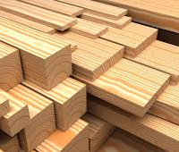

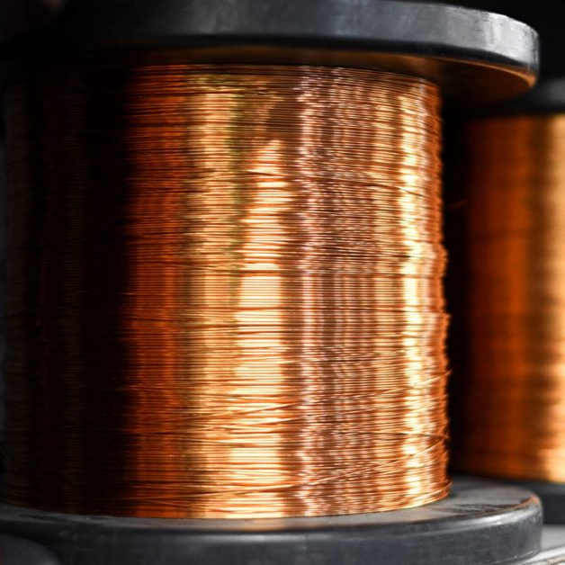
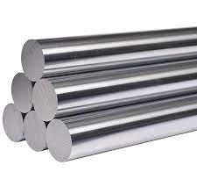
C0MPONENTS
Components | Raw materials
1. WOOD HANDLE | Wood
2. STEEL TIP | Steel rod
3. SHEET METAL CASING | Sheet metal
4.NICHROME WIRE | Nichrome
5. COPPER WIRE | Copper
6. INSULATER | Ceramic
7. CONNECTING WIRE | Copper wire covered by plastic
8. SPRING | Steel
9.PLASTIC BASE | Plastic
Mechanical engineering department,
University of Moratuwa

Slide 4
Intention of selected components
Wood handle
Heat and electric resistor, Better grip, Cheaper, Eco friendly, Easy to obtainable.
steel tip
Cheaper, better heat conductivity, easy to manufacture.
Sheet metal casing
For protection, ventilation.
Nichrome wire
High resistivity, oxidation resistance, high melting point.
Mechanical engineering department,
University of Moratuwa

Slide 5
Intention of selected components
Copper wire
High conductivity, Easily obtainable.
Insulator
Electrical resistance, heat conductivity, usually use mica, high heat capacity.
Connecting wire
Get the power supply from source.
Spring
Holding the soldering iron.
Plastic base
Stabilization of system.
Mechanical engineering department,
University of Moratuwa

Slide 6
Our working plan
Analysis the components& taking measurements
Selecting Material
Improve product in 2D & 3D Modelling
Manufacturing the components
Assembling& testing the components

Slide 7

Thank you
Mechanical engineering department,
University of Moratuwa

